Slide 1
Latent Idiom Recognition for a Minimalist Functional Array Language using Equality Saturation
No library
for (i = 0; i < N; i++) {
sum += xs[i]; }
BLAS
double ones[N] = { 1, 1, … };
ddot(N, xs, 1, ones, 1);
PyTorch
dot(xs, full(N, 1))
–OR–
sum(xs)
Jonathan Van der Cruysse and Christophe Dubach McGill University – CGO ’24 – Tuesday March 5, 2024
Notes:
Merge title slide and slide 2

Slide 2
Levels of abstraction
Domain-specific language
dot(xs, ys)
Functional array programming
reduce(+, map(*, zip(xs, ys)))
Flexibility
Simplicity
Systems programming
sum = 0.0; for (i = 0; i < N; i++) { sum += xs[i] * ys[i];
}

Slide 3
Functional array programming
dot(xs, ys) = reduce(+, map(*, zip(xs, ys)))
zip
map(*, _)
reduce(+, _)
[x₁, x₂]
[
]
[
]
(x₁, y₁),
(x₂, y₂)
x₁ * y₁,
x₂ * y₂
x₁ * y₁ + x₂ * y₂
[y₁, y₂]
Notes:
X in one color, y in another color
Increase zip, map, reduce font size, change to gray color

Slide 4
Idiom recognition
dot(xs, ys) = reduce(+, map(*, zip(xs, ys)))
Dot product
reduce(+, map(*, zip(xs, ys)))
dot(xs, ys)
Vector norm
reduce(+, map(λx. x * x, xs))
dot(xs, xs)
Array sum
reduce(+, xs)
dot(xs, [1, 1, …])

Slide 5
Three ingredients
Minimalist IR
Language rules + library idioms
Equality saturation
build(N, f)@i = f(i) (8 rules in total)
fill(c) = build(N, λi. c) (10 for BLAS, 11 for PyTorch)
map reduce zip join split concat …
ifold N
build ifold
0
λ
xs
λ
+
•₀
@
•₁
Notes:
Improve contrast and test it with a horrible projector

Slide 6
Ingredient #1: Minimalist IR
build(3, f) = [f(0), f(1), f(2)]
ifold(3, f, init) = f(f(f(init, 0), 1), 2)
map reduce zip join split concat …
build ifold
[1]
[1]: A. Shaikhha et al. Destination-passing style for efficient memory management. FHCP 2017
Notes:
“CISC” vs “RISC”
Add citation → shows we’re not overstating our contributions

Slide 7
Idiom recognition on minimalist IR
dot(xs, ys) = reduce(+, map(*, zip(xs, ys)))
dot(xs, ys) = ifold(N, 0, λa. λi. a + xs@i * ys@i)
Dot product
reduce(+, map(*, zip(xs, ys)))
ifold(N, 0, λa. λi. a + xs@i * ys@i)
dot(xs, ys)
reduce(+, map(*, zip(xs, ys)))
Vector norm
ifold(N, 0, λa. λi. a + xs@i * xs@i)
reduce(+, map(λx. x * x, xs))
dot(xs, xs)
reduce(+, map(λx. x * x, xs))
Array sum
ifold(N, 0, λa. λi. a + xs@i)
reduce(+, 0, xs)
reduce(+, 0, xs)

Slide 8
Ingredient #2: Rules and idioms
Language rules
Library idioms (e.g., PyTorch, BLAS)
x = x * 1
dot(A, B) = ifold(N, λa. λi. A@i * B@i + a)
build(N, f)@i = f(i)
fill(c) = build(N, λi. c)

Slide 9
Ingredient #3: Equality saturation
+
+
x / 2 = x >> 1
a / 2 + 2
/
>>
a >> 1 + 2
>>
2
2
a
a
1
1
[2]: R. Tate et al. Equality saturation: a new approach to optimization. POPL ‘09
Notes:
Replace slide w/ trivial application of eqsat

Slide 10
Combining the three ingredients
ifold N
dot
dot
dot(A, B) = ifold(N, λa.λi. A@i + B@i + a)
0
λ
xs
xs
Expressions in e-graph:
x = (λa. x)(y)
f(i) = build(N, f)@i
λ
λ
build N
fill
ifold(N, 0, λa.λi. xs@i + a)
fill
ifold(N, 0, λa.λi. xs@i * 1 + a)
ifold(N, 0, λa.λi. xs@i * build(N, λj. 1)@i + a)
+
fill(c) = build(N, λi. c)
1
@
1
•₀
@
*
ifold(N, 0, λa.λi. xs@i * fill(1)@i + a)
x = x * 1
dot(xs, fill(1))
•₁
Notes:
Highlight in red in the graph the expressions that correspond to the red box
Maybe don’t even show the blue boxes?
Make last blue box disappear
Make it 1 min

Slide 11
Evaluation methodology
PolyBench C
sum = 0.0; for (i = 0; i < N; i++) { sum += xs[i] * ys[i];
}
Minimalist IR
ifold N 0 (λa. λi. a + xs@i)
LIAR
IR with library calls
BLAS
ddot(xs, [1, 1, …])
PyTorch
sum(xs)
[3]
C code
BLAS
double ones[N] = { 1, 1, … };
ddot(N, xs, 1, ones, 1);
[3]: Z. Lin, C. Dubach. From functional to imperative: combining destination-passing style and views. ARRAY 2022

Slide 12
PolyBench: doitgen example
for (int r = 0; r < R; r++) {
for (int q = 0; q < Q; q++) {
for (int p = 0; p < P; p++) {
sum[p] = 0.0;
for (int s = 0; s < P; s++) {
sum[p] += A[r][q][s] * B[s][p];
}
}
for (int p = 0; p < P; p++) {
A[r][q][p] = sum[p];
}
}
}
Notes:
Shrink code, merge slides 16 and 17

Slide 13
PolyBench: doitgen example
build(N, λr. build(N, λq. build(N, λp.
ifold(N, 0, λa. λs. A@r@q@s * B@s@p + a))))
Targeting PyTorch
build(N, λr. mm(A@r, transpose(B)))
Targeting BLAS
build(N, λr. dgemm^{F,T}(1, A@r, B, 0, build(N, λq. memset(0)))

Slide 14
Solutions over time doitgen benchmark
PyTorch
BLAS
Notes:
Point out that we’re hitting the limits of eqsat rather than LIAR itself
Try to do these graphs for doitgen rather than gemv
How long does it take to step 6? → 5 minutes

Slide 15
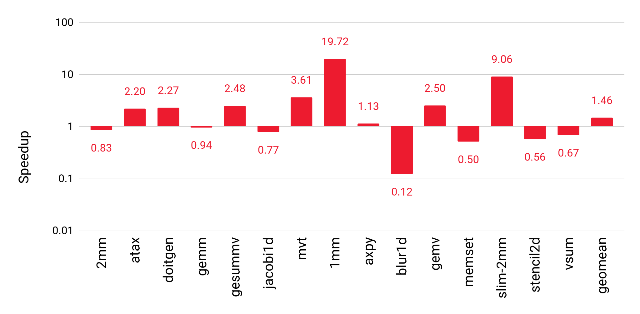
Run time speedup Compared to PolyBench C kernels, BLAS parallel CPU library
Notes:
Explain baseline visually using thick black line at 1. Start by showing empty graph with black line
Increase font size to smallest other font size on slide
Round to one digit after decimal point
Highlight poorly-performing benchmarks and explain why they perform poorly
What device + library are we running things on? → Put it in the title
Know the answer to the input size question

Slide 16
Conclusion
Minimalist IR simplifies semantics
Language rules + library idioms scheme adapts to different APIs
Equality saturation transforms programs to find idioms
More details in paper
De Bruijn indices, full rules + idioms, etc.
Future work: Improve scalability of equality saturation
Jonathan’s home page
Notes:
Put URL of my website as QR code
Have bullet points that correspond to paper contributions

Slide 17
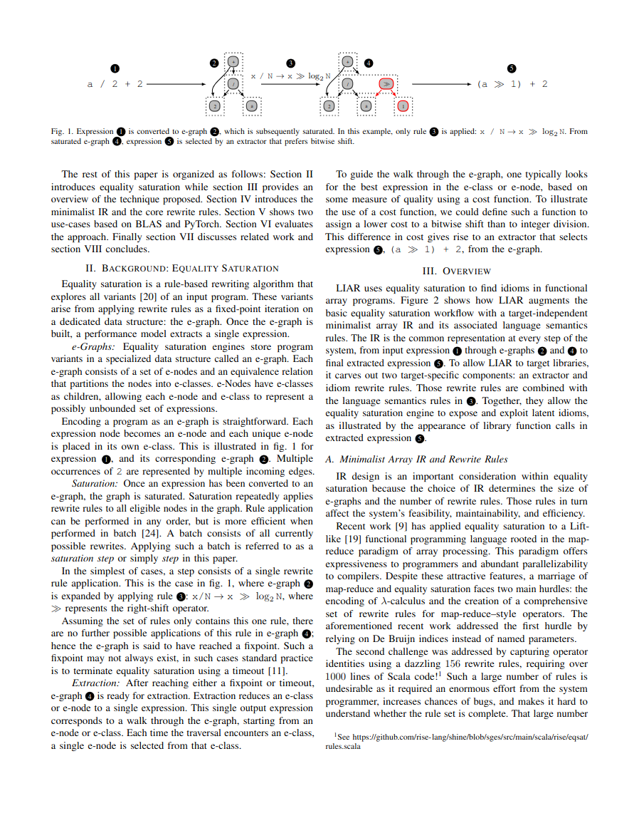
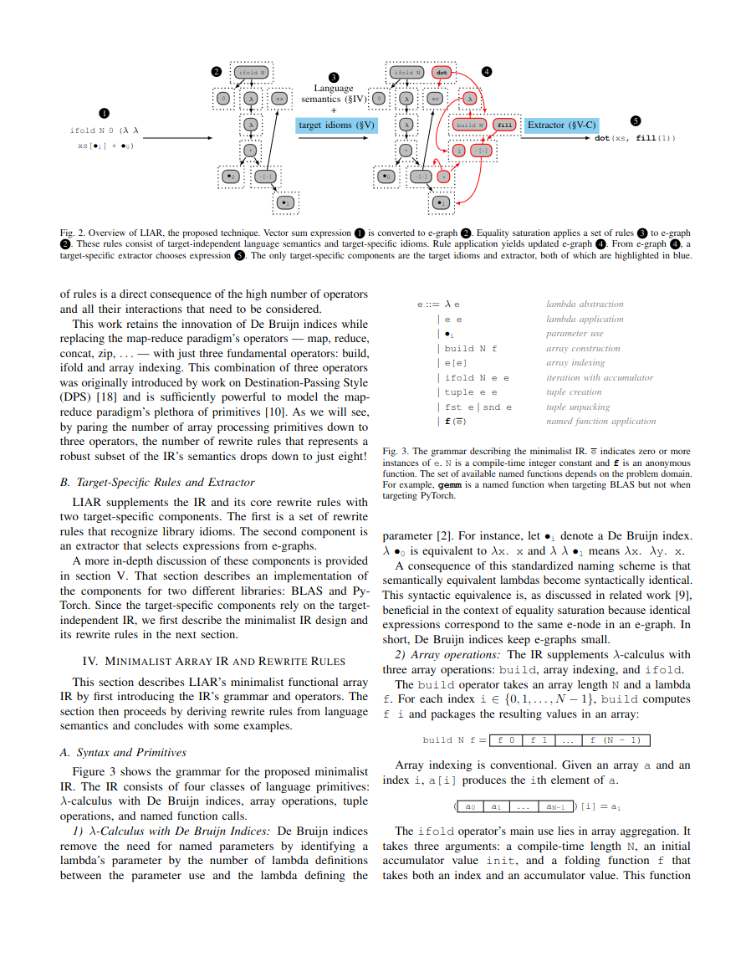
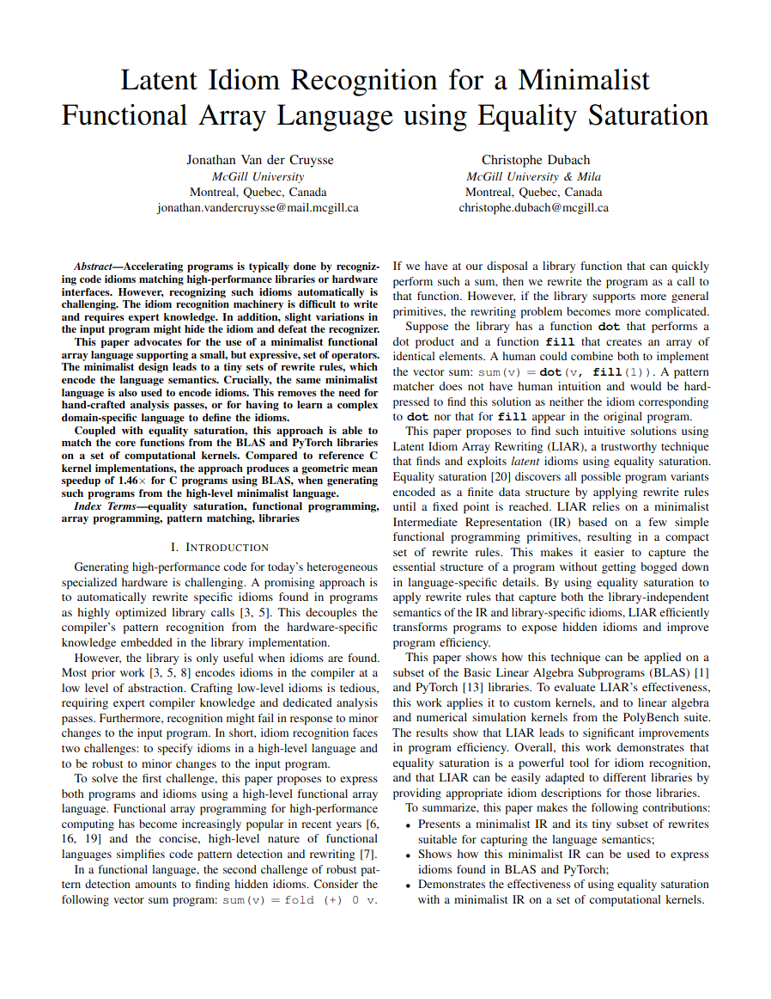

Slide 18
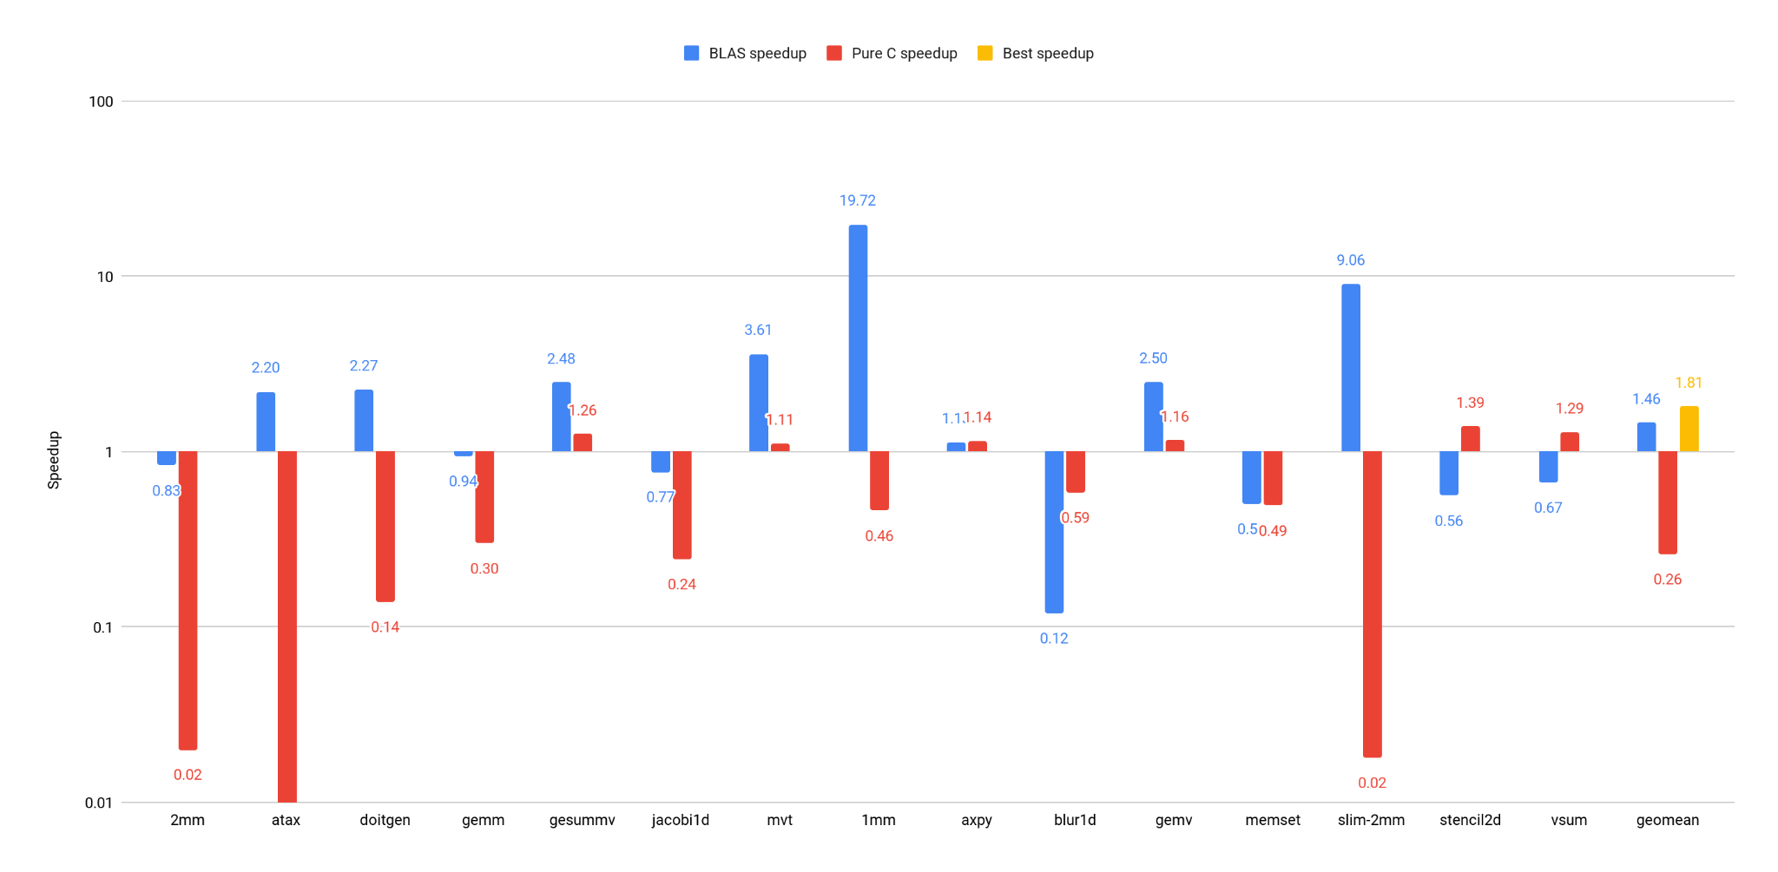
Run time speedup Compared to reference kernels
Notes:
Make the graph bigger (and readable)
First show doitgen! Explain what red bar, blue bar are
Another slide: how long does it take to find these things?
Keep detailed graph as backup slide
Then show other benchmarks
Remove red bars and yellow bar, talk about baseline
Mention the time budget

Slide 19
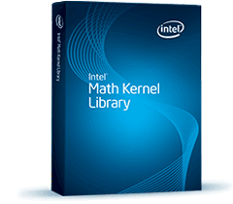
BLAS and PyTorch
BLAS
Library specification
Linear algebra
Complex API
dgemm( transa, transb, m, n, k, alpha, a, lda, b, ldb, beta, c, ldc)
PyTorch
Library
Machine learning
Streamlined API
mm(a, b) add(a, b) mul(a, b) transpose(a)
Notes:
Introduce why BLAS and PyTorch
→ data point (X% of people use PyTorch)
→ BLAS is a library interface from the eighties that is still in widespread use
→ Highly optimized implementations of the primtiives they provide on different devices

Slide 20
LIAR in action
dot(xs, ys) = ifold N 0 (λa. λi. a + xs_{i} * ys_{i})
Dot product
ifold N 0 (λa. λi. a + xs_{i} * ys_{i})
dot(xs, ys)
reduce (+) (map (*) (zip xs ys))
Vector norm
ifold N 0 (λa. λi. a + xs_{i} * xs_{i})
dot(xs, xs)
reduce (+) (map (λx. x * x) xs)
Array sum
ifold N 0 (λa. λi. a + xs_{i})
dot(xs, fill(1))
reduce (+) 0 xs
Notes:
Include grayed out map/reduce (make it same slide as before)
Maybe no need to show this again?

Slide 21
Equality saturation pipeline

Slide 22
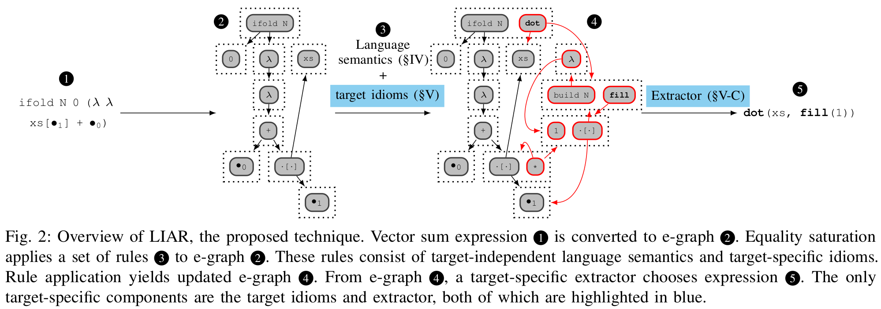
LIAR pipeline overview

Slide 23
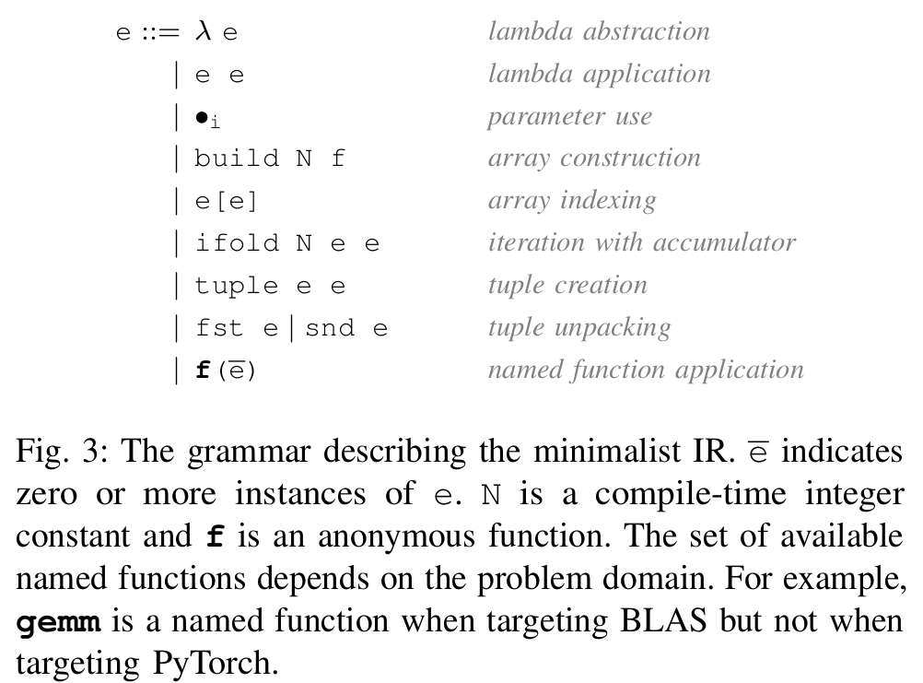
IR grammar

Slide 24
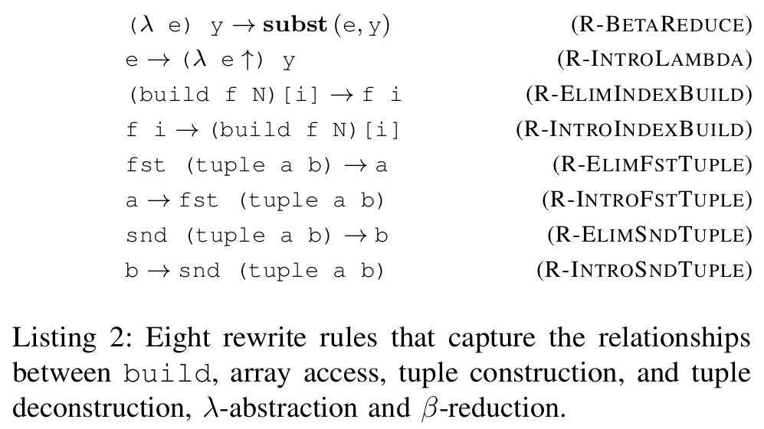
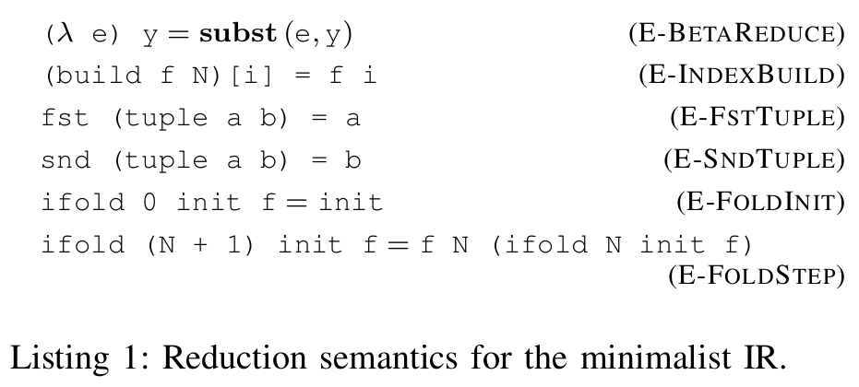
IR semantics

Slide 25
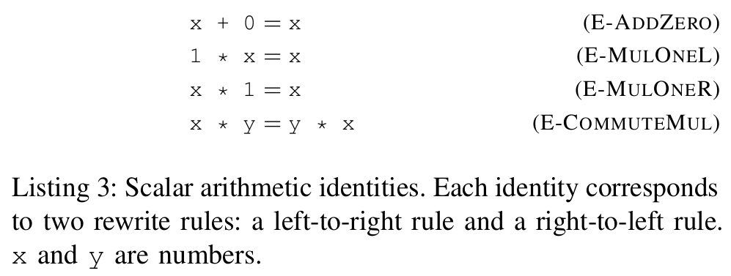
Arithmetic identities

Slide 26
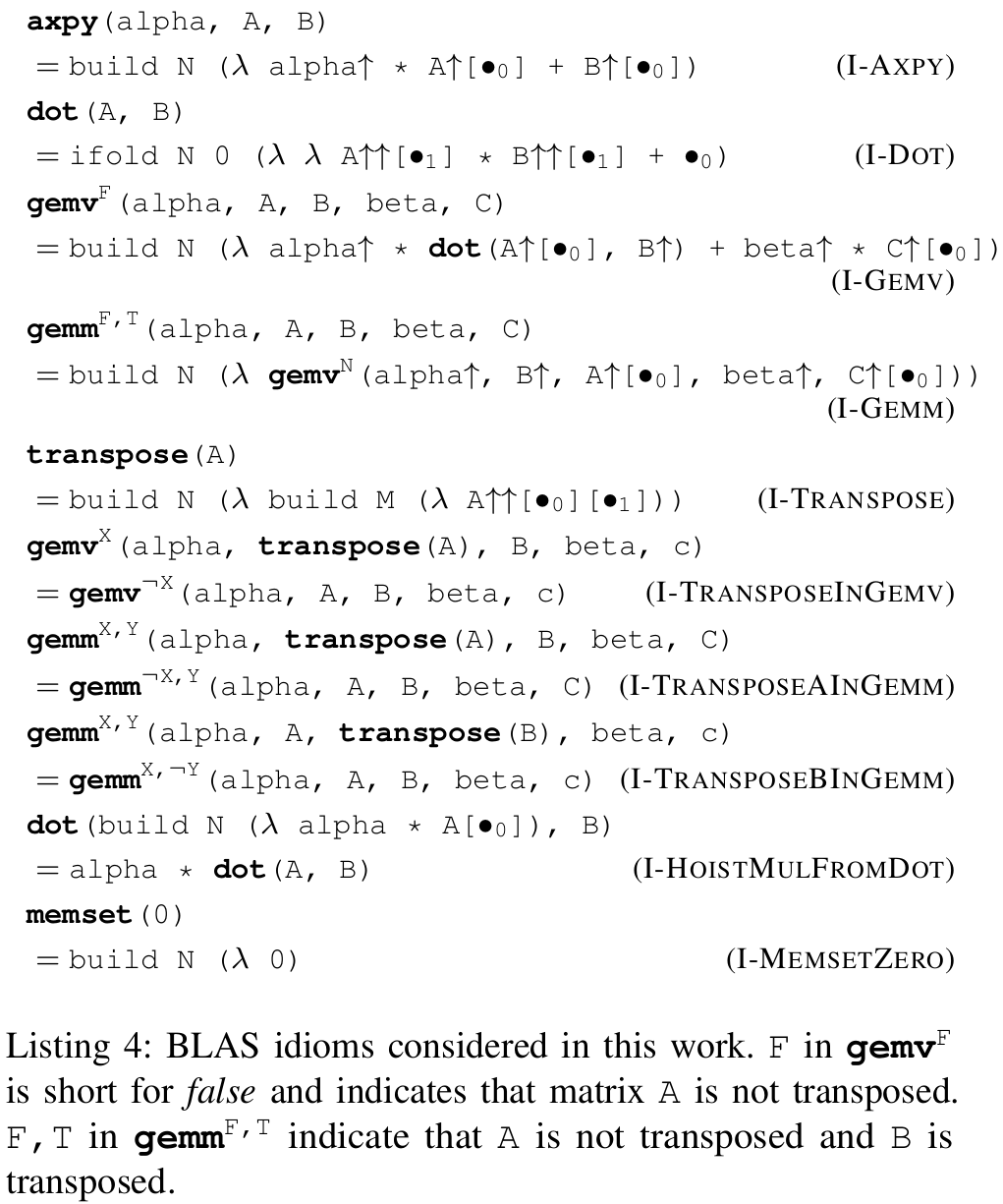
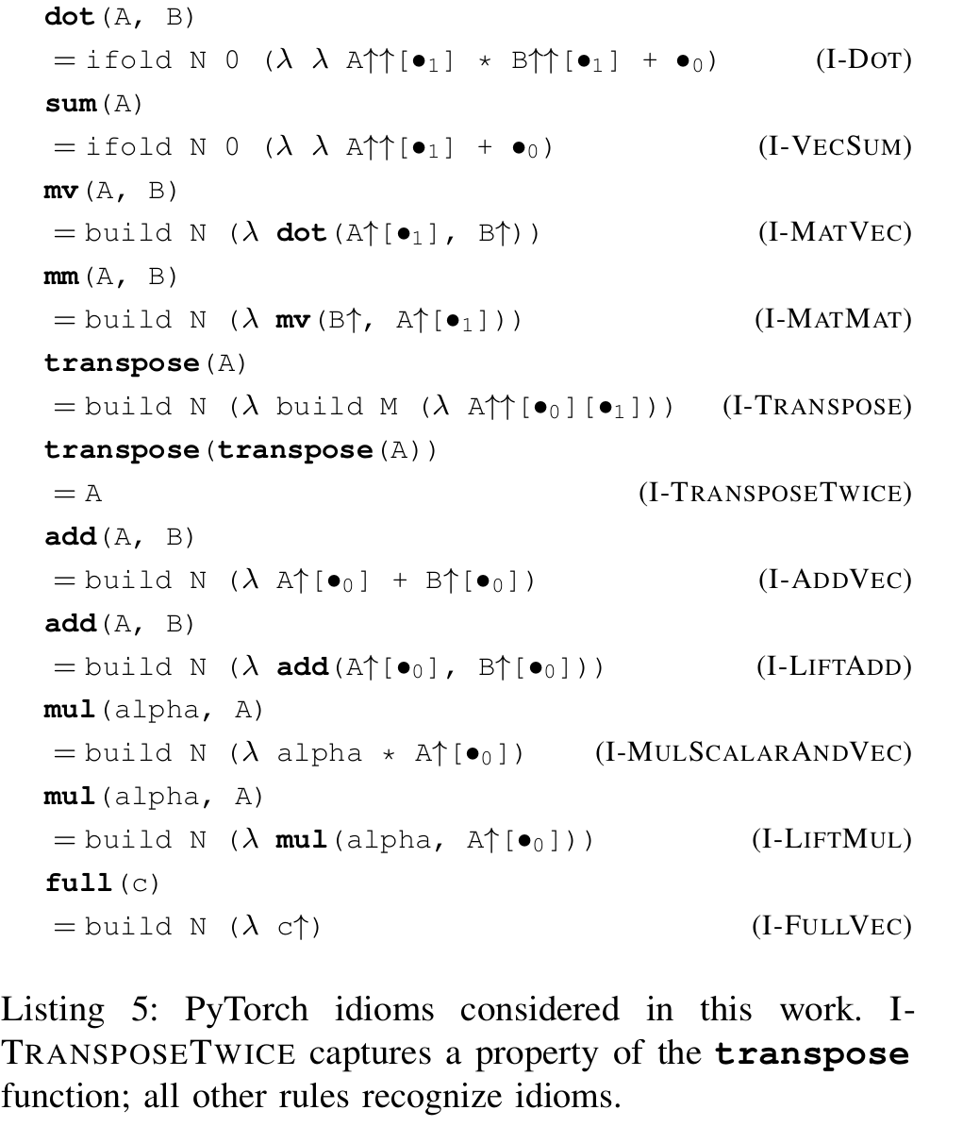
BLAS and PyTorch idioms

Slide 27
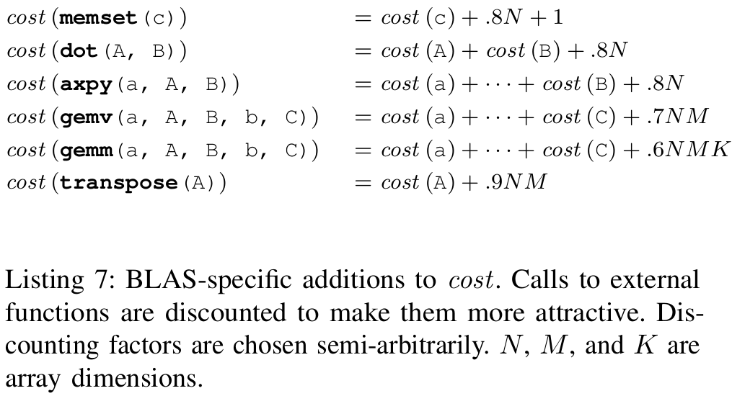
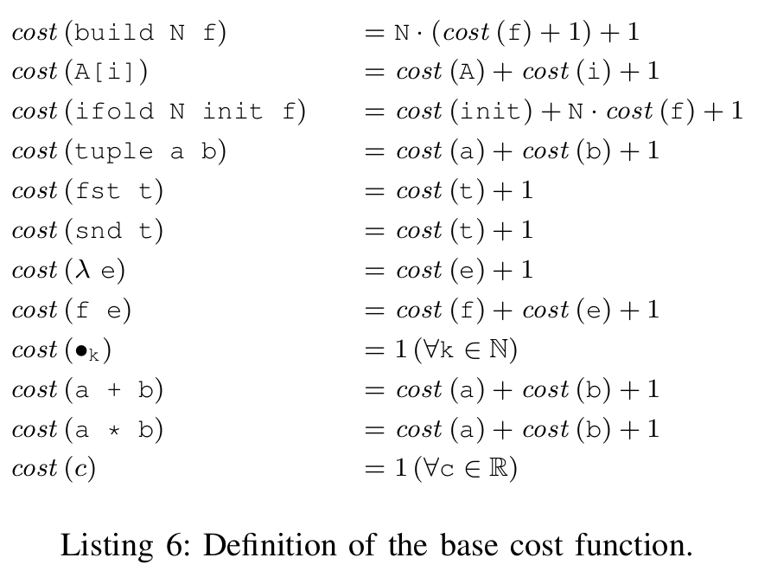
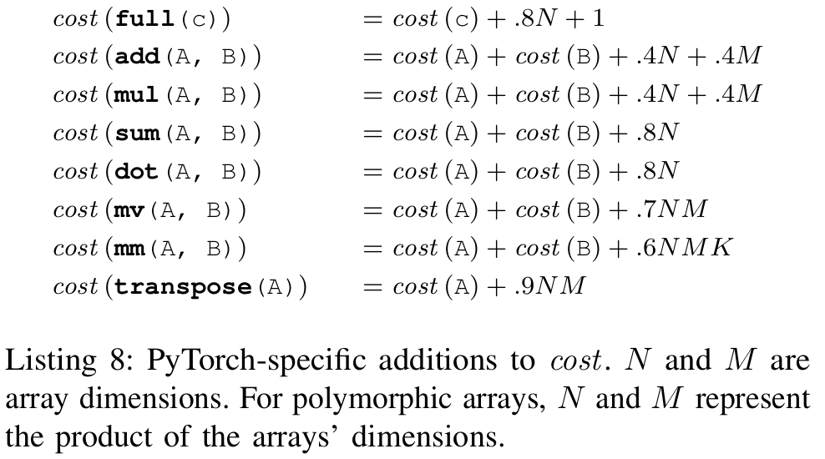
Cost model

Slide 28
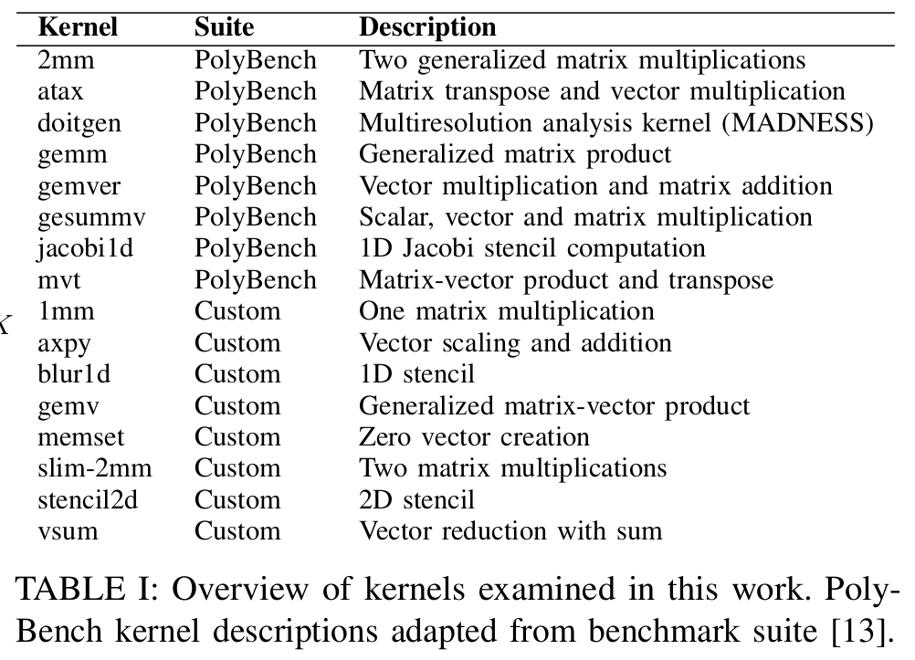
Overview of kernels

Slide 29
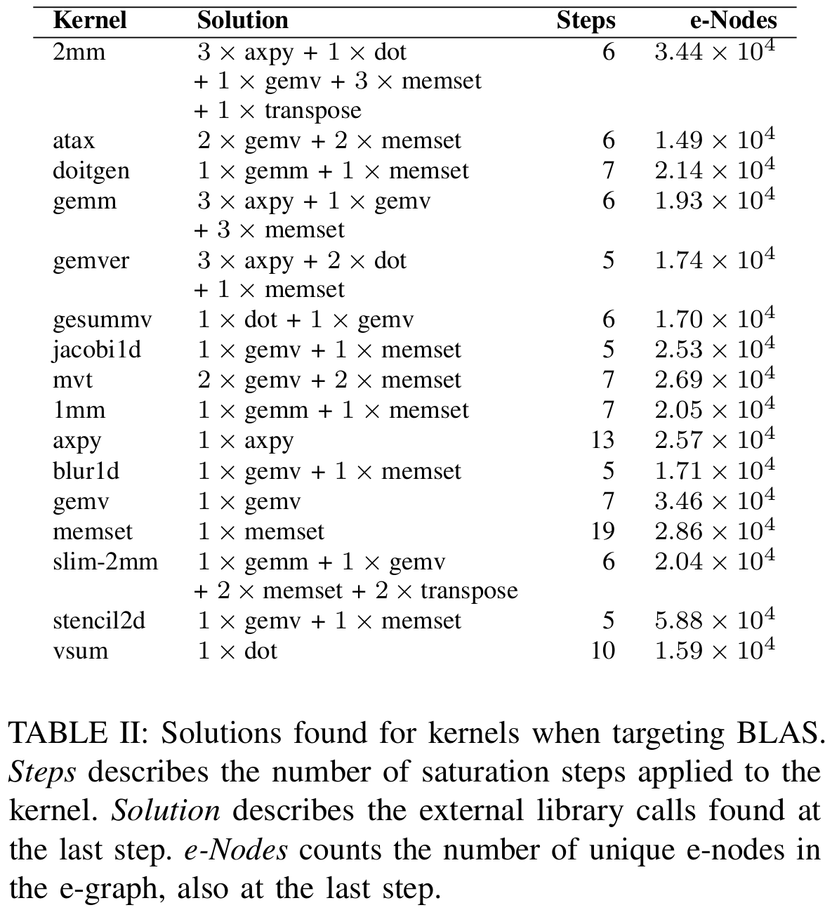
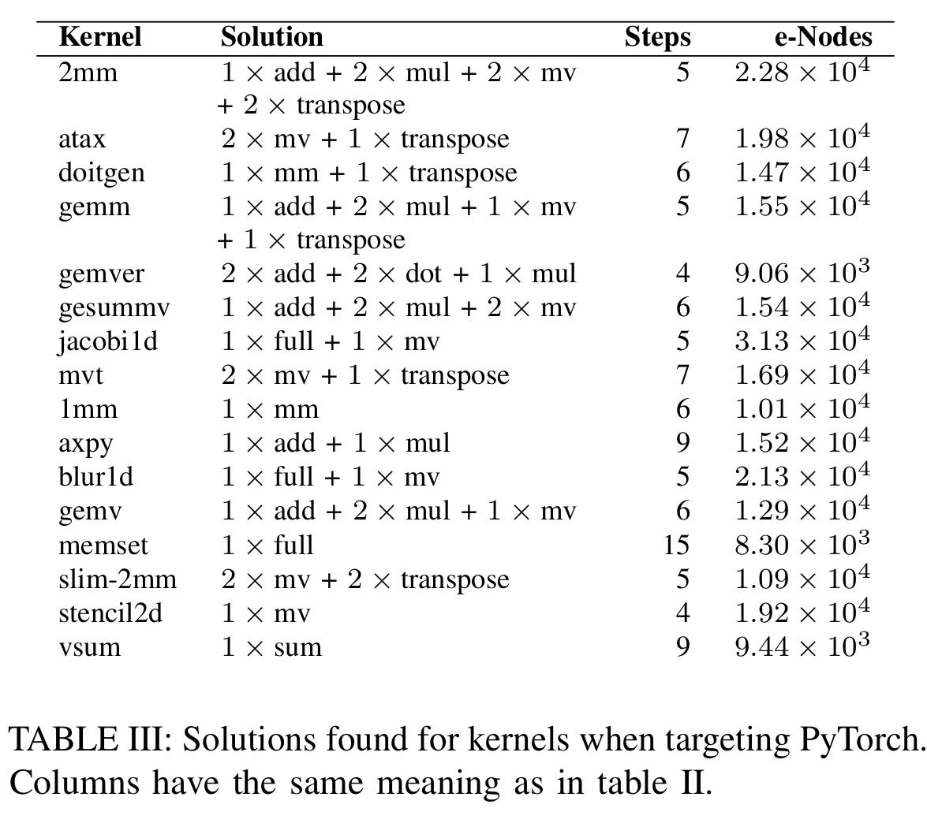
Solutions found

Slide 30
Solutions over time

Slide 31
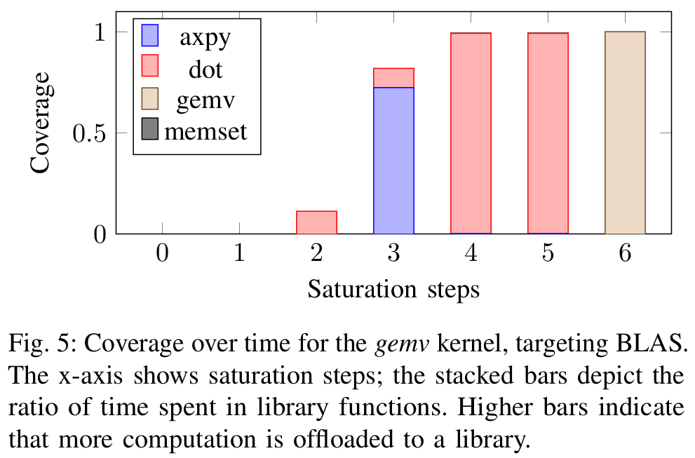
Coverage over time

Slide 32
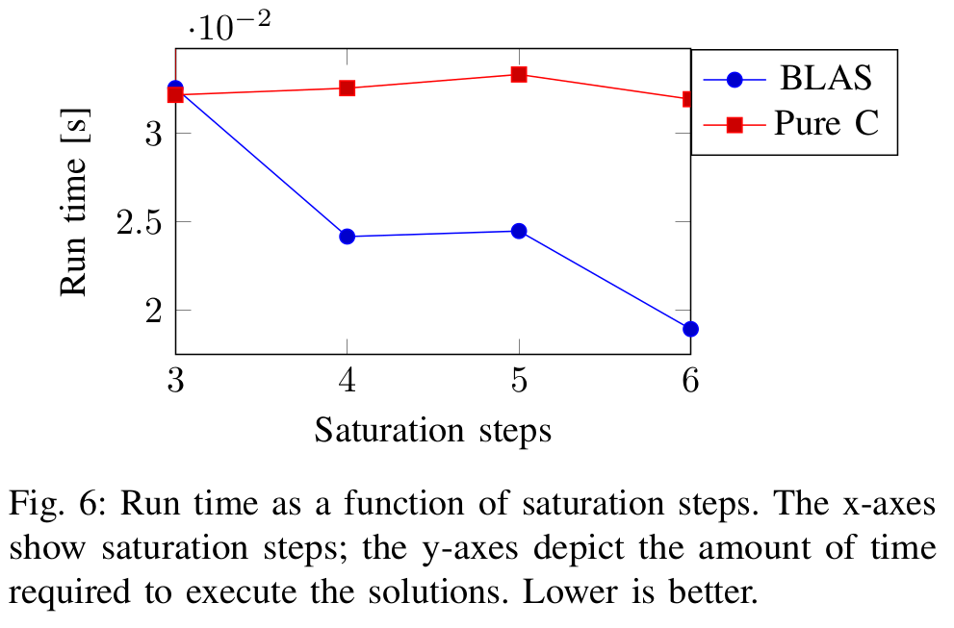
Run time over time

Slide 33
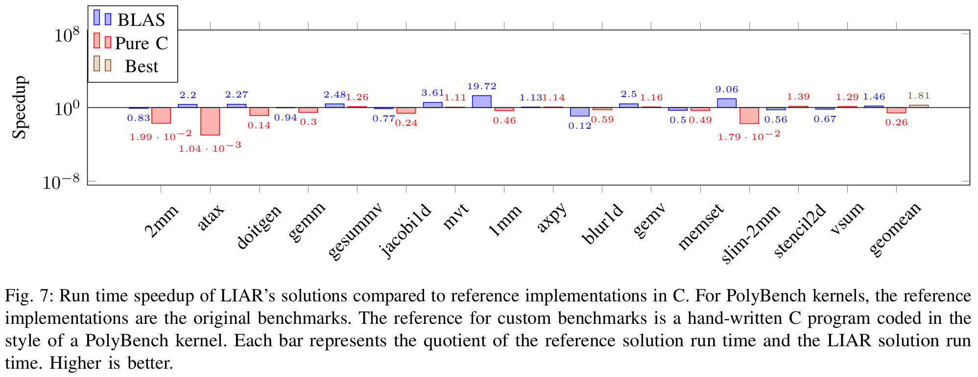
Run time speedup

Slide 34
Functional array programming
map f [x₁, x₂] = [f x₁, f x₂]
reduce f init [x₁, x₂] = f (f init x₁) x₂
zip [x₁, x₂] [y₁, y₂] = [(x₁, y₁), (x₂, y₂)]
Also: join, split, concat, slide, …
Notes:
Perhaps use parentheses for function arguments
Merge slides 3 and 4 into one slide → define what the function

Slide 35
Rewrite rules: naive approach
map g (map f as) → map (g ∘ f) as
zip (map f as) (map g bs) → map (λt. (f t₁, g t₂)) (zip as bs)
map (λa. f a a) as → map (λt. f t₁ t₂) (zip as as)
map (λa. f a c) as → map (λt. f t₁ t₂) (zip as [c, c, …])
as → map (λa. a) as
How many rules do we need?
Notes:
Keep same content but add colors to highlight patterns / line up content
Do something visual to show LHS is replaced by RHS (double columns?)
Replace cross and write down message: keyword – how many more rules do we need?
Don’t spend more than a minute on this slide → only describe first two lines

Slide 36
De Bruijn indices
Named variables
λx. x λx. λy. y λx. λy. x λx. λy. λz. z
De Bruijn indices
λ •₀ λ λ •₀ λ λ •₁ λ λ λ •₂

Slide 37
Latent idioms
Original computation
2D convolution
PyTorch
conv2d( A, weights )
BLAS
gemm( im2col(...), weights’ )

